Slide 1
DECEMBER 7, 2023
HOMELESSNESS
IN THE LARGEST METRO AREAS OF THE US
DANIEL, JACOB, KYLE, LAWRIE, MANYA, PARVATI, SARAH
Notes:
Our dashboard helps researchers, policymakers, & advocates visually explore

Slide 2
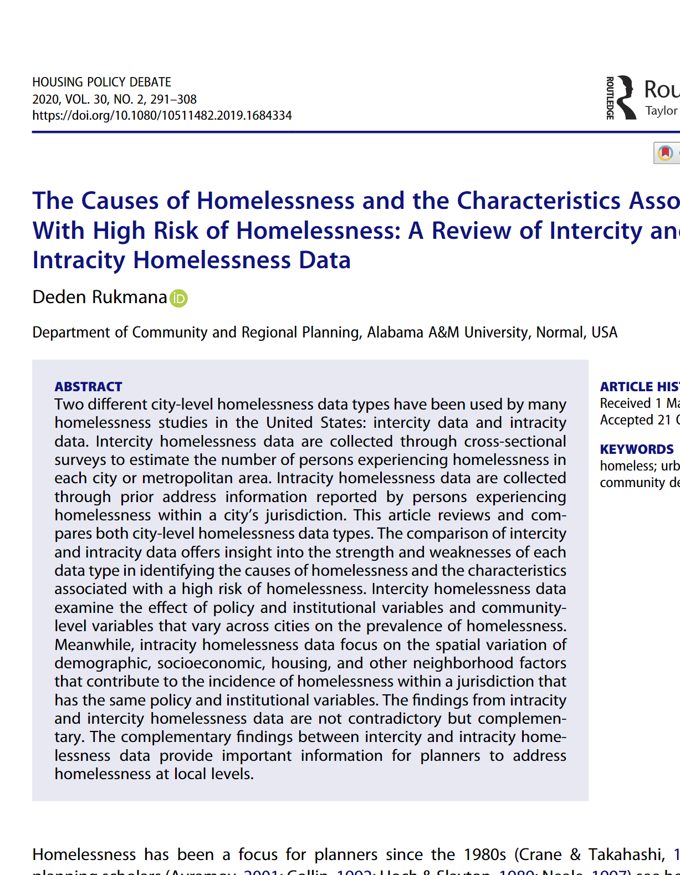
Research Links Six Factors to Homelessness
Housing
Public Health
Demographics
Economic Trends
Safety Nets
Public Policy

Slide 3
November 24, 2023
OUR CHARACTERISTICS
Housing | House Price Index 1-bedroom Rental Prices
Demographics | # of people of various genders # of people in race/ethnicity categories # of people in different age categories
Economics | Inflation Unemployment Median income
Public Health | # of people uninsured # of people with a disability # of Deaths Caused by Alcohol, Drug Overdose
Safety Nets | SNAP recipients Number of beds

Slide 4







WHERE OUR DATA COMES FROM
Homelessness Count, Demographics, 1-bedroom rental
Median Income, Number of Beds, SNAP recipients
Number of uninsured people
Population, Average Income
Inflation, Unemployment
Making Available as Asset for Researchers
Housing Price Index
Accidental & Overdose Deaths
Integrated Homelessness Dataset

Slide 5


City
Company Name
November 24, 2023
OUR DESIGN
USER INTERVIEW FEEDBACK
Incorporated variables weren’t fully explained or given context
Predictiveness was hard to interpret
“Policy people love numbers but hate doing the math”
to meet the needs of our anticipated users:
Policymakers
NGOs
Researchers
CHANGES IN RESPONSE
Adding tooltips detailing the MSA, homelessness rate, and population - visible on map hover
Clear summaries of our predictors, their meanings, and contextual ranges
Predictiveness now displays R² with simple barchart
Added explicit explanation of lag regression model
reallygreatsite.com
@reallygreatsite

Slide 6
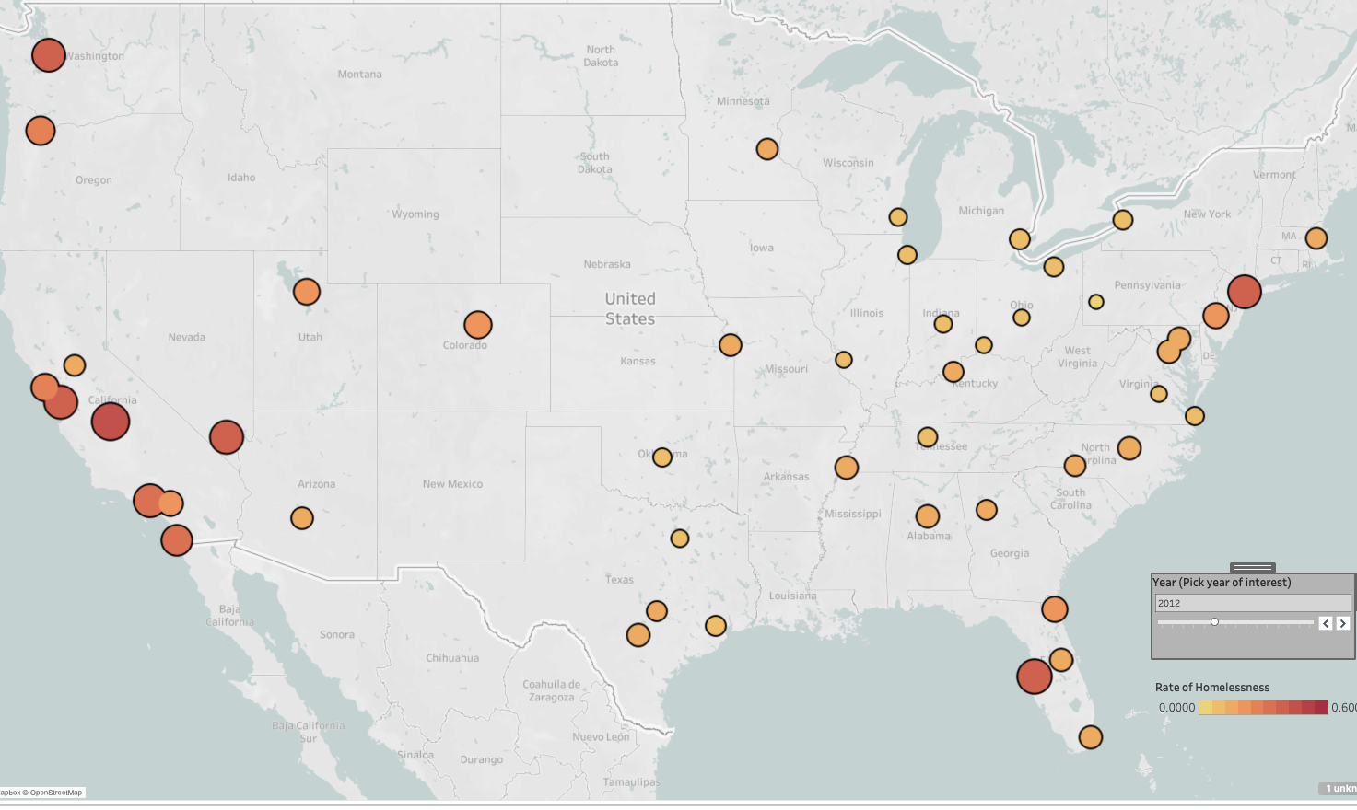
SELECT A CITY
TO START

Slide 8


